Slide 1
UGRP Innovation
Nimil Shah Mentor:Brijesh Soni

Slide 2
Background
An unprecedented growth in mobile data due to rapid development of mobile devices and wireless communications generates a large amount of data traffic everyday.
In such a scenario, effective innovations are in need to enhance the network capacity and user-experience.
Co-existence of Wi-Fi and LTE Unlicensed (LTE-U) in shared or unlicensed groups has drawn developing consideration from both scholarly community and industry to enable more efficient spectrum utilization and provide greater broadband capacity.

Slide 3
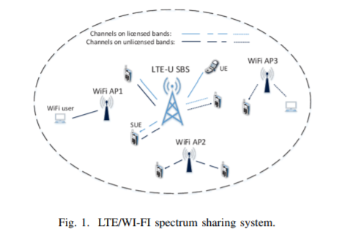

Slide 4
Motivation
LTE-U duty cycle method that has been mentioned in, where both WIFI and LTE transmits for equal duration for fair coexistence.
However a drawback of this approach turns out is both WIFI and LTE tries to access the same spectrum without identifying vacant frequency bands in the spectrum
.
Resulting in condense transmission duration for both the technologies.
A mechanism whereby one of the technologies is trained to identify vacant frequency bands during transmission and allocated itself to such bands will result in higher data rate and increase in efficiency of spectrum utilization.

Slide 5
Innovation Framework
Although the LTE system cannot know exact WIFI traffic demands, the LTE system can monitor WIFI channels to obtain WIFI channel activity i.e. the number of busy and idle slots.
We developed LSTM based algorithm to correctly identify WI-FI signals from a dataset. This algorithm will make it easy for a LTE system to monitor WIFI traffic demands.

Slide 6
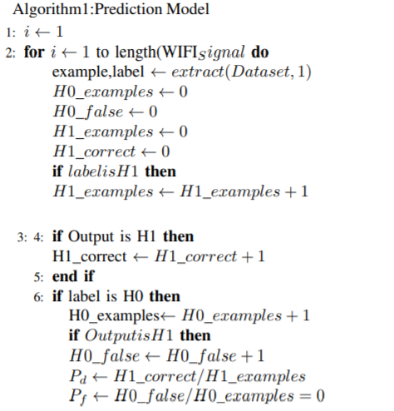
Algorithm

Slide 7
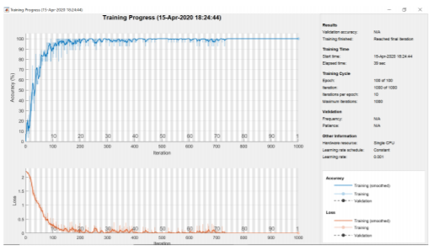
LSTM TRAINED MODEL

Slide 8
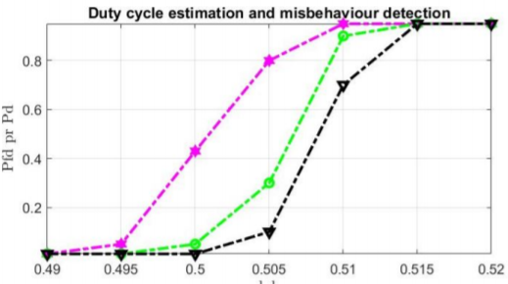
Results

Slide 9
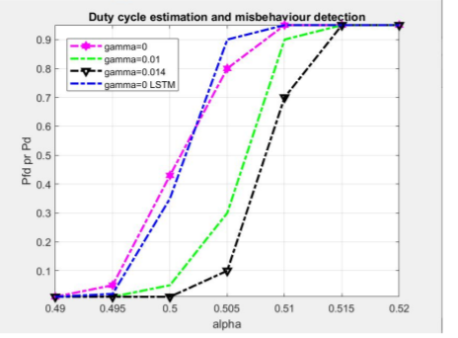
Results

Slide 10
Referneces
X. Ying, R. Poovendran and S. Roy, "Detecting LTE-U duty cycling misbehavior for fair sharing with Wi-Fi in shared bands," 2017 IEEE 28th Annual International Symposium on Personal, Indoor, and Mobile Radio Communications (PIMRC), Montreal, QC, 2017, pp. 1-7, doi: 10.1109/PIMRC.2017.8292197.

